Slide 1
Job Interference

Slide 2
Experiment
Nvidia MPS
Ran each script for long times (tweaking #epochs)
Ran short script for short times (tweaking #epochs) , recording average time/10 iter across whole training session
Ran pairs of scripts together and estimated average completion time for same-length batch (using console output again)

Slide 3
Experiment (cont.)
Max batch size chosen such that total GPU memory usage < 50% to allow packing to occur
Variables: Model architecture, dataset, batch size
GPU Util measured by monitoring & estimating nvida-smi over course of training
Possible Errors:
Some models were not actually converging
Slight variation in runtimes

Slide 4
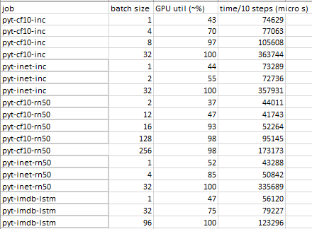
Results – Individual Runs

Slide 5
Results – Individual Runs (cont.)
Format: Platform-Dataset-Model
Batch size heavily influences GPU util, time (expected)
Unknown small jump of util from 12->16 batch size on pyt-cf-rn
GPU util not linear at all with batch size (expected)
Runtimes after hitting 100% GPU Util on small batch size is very roughly linear (cf-rn50 128 -> 256 size, cf-inc 8 -> 32 size)

Slide 6
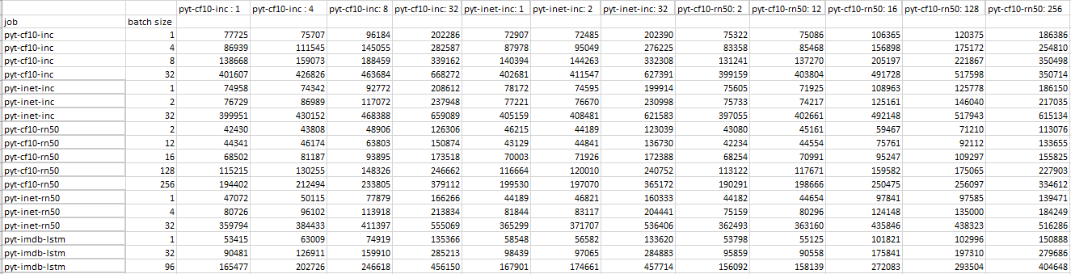
Results – Packing, Raw Times
Note: Table is too large to fit into picture completely (same with the rest of the tables in this presentation)

Slide 7
Results – Packing, Raw Times (cont.)
Cell (A, B) is runtime of A running with B (average time/10 steps)
Example: pyt-cf10-inc-1 has an average of 75707 microseconds/10 steps when paired with pyt-cf10-inc-4, whereas pyt-cf10-inc-4 is 86939 microseconds/10 steps with pyt-cf10-inc-1 (asymmetrical)
Note: Inceptionv3 requires fixed 299x299 input size
cf10 and imagenet images around same computationally from data transform
ResNet50 can take different image sizes, so imagenet vs cf10 is different
GPU Utilization for two jobs do not scale linearly
Example: pyt-cf-inc-1 (indiv util 43%) + pyt-imdb-lstm-1 (indiv util 47%) => 75% packed util
LSTM model packing would often only reach 95% and not 100% (unknown)

Slide 8
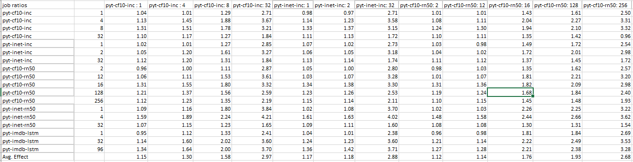
Results – Packing, Individual Ratios

Slide 9
Results – Packing, Individual Slowdown
Cell (A, B) is the ratio of (runtime A with B) / (individual A)
Measures the time slowdown of A when running with B (asymmetrical)
Larger jobs generally are less prone to interference but cause a lot of interference
Terms: Sensitivity to Interference (row) vs Effect on Interference (col)
Example: Sensitivity avg of pyt-inet-rn50-32 is 1.26, but effect avg is 3.43
As a result, jobs with high sensitivity are generally balanced by low effect or vice versa
Packing jobs with somewhat low (<70%) GPU utilization generally causes low amounts of interference

Slide 10
Results – Packing, Individual Slowdown
Effect and sensitivity to interference is strongly correlated with batch size
Batch size may not be the cause – it may be number of FLOPs or something else
Example: pyt-cf10-inc-8 is a typical “small” job with high sensitivity = avg 1.93, low effect = avg 1.58
pyt-cf10-inc-32 is a typical “big” job with low sensitivity = avg 1.30, high effect = avg 2.97
Compare rows of pyt-cf10-inc with different batch sizes
There exists a “cutoff” where small job becomes a large job

Slide 11
Results – Packing, Individual Slowdown
Small jobs still perform well when packed with another small job
GPU Utilization (%) seems like a suitable estimator for small vs larger jobs
Example:

Slide 12
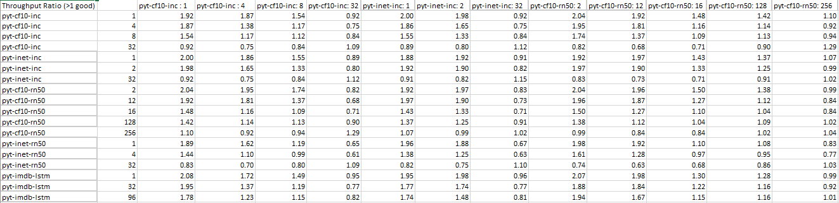
Results – Packing, Paired Throughput Ratio

Slide 13
Results – Packing, Paired Throughput Ratio
Throughput (TP) defined as #iters/fixed time unit
Individual TP (ITP) by reciprocal of raw times (10/x iters / microsecond where x = raw time measurement)
Paired TP (PTP) for jobs (A, B) defined as (TP(A) + TP(B) when A is packed with B)
PTP Ratio (A, B) defined as PTP (A, B) / (ITP(A) + ITP(B))
Multiplied by 2 to show usage of half the amount of resources as individual + individual
Upper bound = 2 (showing no interference) ignoring natural variance, PTP Ratio = 1 shows interference is exactly 50%
Example: pyt-cf-inc-1 with pyt-inet-inc-1 has PTP Ratio = 2, or there is almost no interference in total iters/time

Slide 14
Results – Packing, Paired Throughput Ratio
Large jobs having low sensitivity and high effect means that PTP Ratio can still be okay despite average of ratios being low
Example: job pyt-cf10-rn50-256 (A) with job pyt-cf10-inc-8 (B)
A runs 1.35 slower when with B, B runs 3.32x slower with A
Average of ratio: 2.33; seems like packing is a lot worse
PTP Ratio is only 0.94; packing is only around 6% slower which is not hugely detrimental to overall performance
PTP Ratio generally > 1 except for the largest jobs

Slide 15
Results - Overall
Both PTP Ratio and Average of Ratios generally show that a small (<70%) job with another small job give good gains through packing
Example: pyt-cf10-inc-4 (A) with pyt-inet-rn50-1 (B)
A has util ~70%, B has util ~52%
A experiences 1.39x slowdown, B experiences 1.16x slowdown for packing (average of slowdown ratio 1.28x, PTP ratio 1.62x)
Even smaller (double <60%) are nearly 1x slowdown ratio and 2x PTP (practically no interference)
Among the small jobs, the job type and dataset do not seem to matter much (consistently not much observed interference)

